Slide 1
Hierarchical cluster Analysis
Hierarchical clustering is another unsupervised machine learning algorithm, which is used to group the unlabeled datasets into a cluster and also known as hierarchical cluster analysis or HCA.

Slide 2
HCA intro
In this algorithm, we develop the hierarchy of clusters in the form of a tree, and this tree-shaped structure is known as the dendrogram.
Sometimes the results of K-means clustering and hierarchical clustering may look similar, but they both differ depending on how they work.
As there is no requirement to predetermine the number of clusters as we did in the K-Means algorithm.

Slide 3
Two Approach in HCA
Agglomerative: Agglomerative is a bottom-up approach, in which the algorithm starts with taking all data points as single clusters and merging them until one cluster is left.
Divisive: Divisive algorithm is the reverse of the agglomerative algorithm as it is a top-down approach.

Slide 4
Why hierarchical clustering?
As we have seen in the K-means clustering that there are some challenges with this algorithm, which are a predetermined number of clusters, and it always tries to create the clusters of the same size.
To solve these two challenges, we can opt for the hierarchical clustering algorithm because, in this algorithm, we don't need to have knowledge about the predefined number of clusters.

Slide 5
Agglomerative Hierarchical clustering
The agglomerative hierarchical clustering algorithm is a popular example of HCA.
To group the datasets into clusters, it follows the bottom-up approach.
It means, this algorithm considers each dataset as a single cluster at the beginning, and then start combining the closest pair of clusters together.
It does this until all the clusters are merged into a single cluster that contains all the datasets.

Slide 6
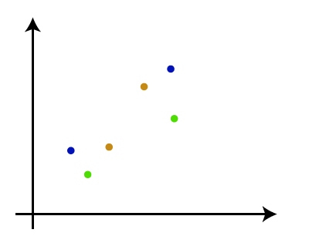
Agglomerative Hierarchical clustering Work
Step-1: Create each data point as a single cluster. Let's say there are N data points, so the number of clusters will also be N.

Slide 7
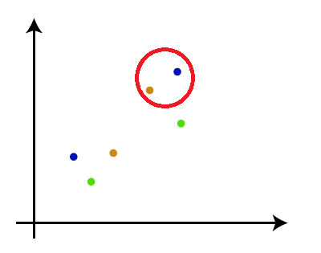
Step-2:
Take two closest data points or clusters and merge them to form one cluster. So, there will now be N-1 clusters.

Slide 8
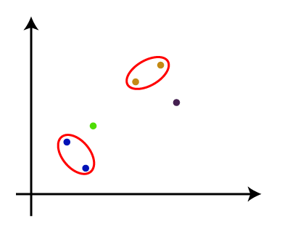
Step-3:
Again, take the two closest clusters and merge them together to form one cluster. There will be N-2 clusters.

Slide 9
Step-4:
Repeat Step 3 until only one cluster left. So, we will get the following clusters. Consider the below images:

Slide 10
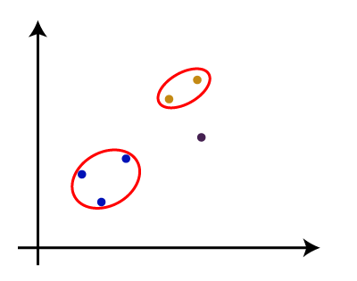
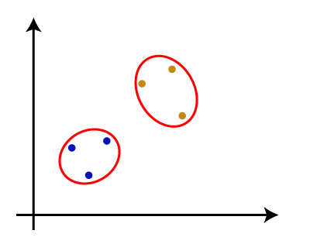
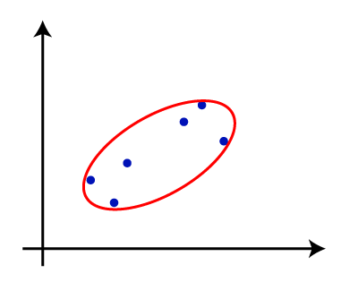

Slide 11
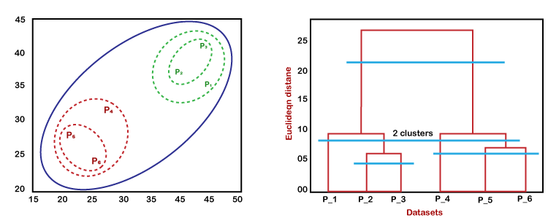
Step-5: Once all the clusters are combined into one big cluster, develop the dendrogram to divide the clusters as per the problem.

Slide 12
Hierarchical clustering, also known as hierarchical cluster analysis or HCA, is an unsupervised machine learning algorithm that creates a hierarchical representation of the clusters in a dataset. The method starts by treating each data point as a separate cluster and then iteratively combines the closest clusters until a stopping criterion is reached.

Slide 13
Steps of the Hierarchical Clustering Algorithm:
1. Data Preprocessing: Before applying the hierarchical clustering algorithm, it is important to preprocess the data to ensure that it is suitable for analysis. This may involve tasks such as normalizing the data, handling missing values, and converting categorical variables into numerical representations.

Slide 14
2. Distance Matrix Calculation: A distance matrix is created to represent the pairwise distances between all data points. The choice of distance metric depends on the nature of the data. Common distance metrics include Euclidean distance, Manhattan distance, and Minkowski distance.

Slide 15
Cluster Initiation: Initially, each data point is considered as a separate cluster. This forms the base of the hierarchical structure.
Iterative Merging or Splitting: The algorithm iteratively merges the closest clusters or splits the most diverse clusters, based on the chosen linkage criterion. Common linkage criteria include single linkage, complete linkage, and average linkage.

Slide 16
Linkage Criterion Selection: The linkage criterion determines how the distance between clusters is calculated. Different linkage criteria lead to different hierarchical structures.
Stopping Criterion: The algorithm stops when a pre-defined stopping criterion is met. Common stopping criteria include a maximum number of clusters, a minimum threshold for cluster similarity, or a desired level of granularity.

Slide 17
Dendrogram Generation: A dendrogram is a tree-like diagram that visually represents the hierarchical clustering process. It shows the merging or splitting of clusters at each step of the algorithm.
Cluster Extraction: The final clusters are extracted from the dendrogram by choosing a desired level of granularity or cutting the dendrogram at a specific height.

Slide 18
Advantages of Hierarchical Clustering:
Easy to understand and implement
Produces a hierarchical structure of clusters
Can handle both numerical and categorical data
Applicable to a wide range of data types

Slide 19
Disadvantages of Hierarchical Clustering:
Sensitive to the choice of distance metric and linkage criterion
Computationally expensive for large datasets
May not always produce the most optimal clustering results

Slide 20
Example.
let's consider a simple example of hierarchical clustering using the customer purchase data from a supermarket. The data consists of the purchase amounts for 10 different customers on five different items: milk, bread, eggs, apples, and oranges.
Step 1: Data Preprocessing
The data is preprocessed by normalizing the purchase amounts to range between 0 and 1. This ensures that all items have an equal influence on the clustering process.

Slide 21
Step 2: Distance Matrix Calculation
The Euclidean distance is used to calculate the pairwise distances between customers based on their normalized purchase amounts. The distance matrix is shown below:
Customer | Milk | Bread | Eggs | Apples | Oranges
---------|-------|-------|-------|-------|-------
Customer 1 | 0.8 | 0.2 | 0.3 | 0.5 | 0.2
Customer 2 | 0.6 | 0.4 | 0.1 | 0.3 | 0.6
Customer 3 | 0.4 | 0.4 | 0.5 | 0.4 | 0.3
Customer 4 | 0.2 | 0.6 | 0.4 | 0.2 | 0.6
Customer 5 | 0.1 | 0.8 | 0.7 | 0.1 | 0.3
Customer 6 | 0.9 | 0.1 | 0.1 | 0.1 | 0.8
Customer 7 | 0.7 | 0.3 | 0.2 | 0.8 | 0.0
Customer 8 | 0.5 | 0.5 | 0.5 | 0.5 | 0.5
Customer 9 | 0.3 | 0.7 | 0.8 | 0.7 | 0.2
Customer 10 | 0.2 | 0.2 | 0.2 | 0.8 | 0.8

Slide 22
Distance between Customer 1 & Customer 2
how to calculate the distance between Customer 1 and Customer 2 for the items milk, bread, eggs, apples, and oranges:
Step 1: Normalize the data
Normalize the purchase amounts for each item to a range between 0 and 1. This ensures that all items have an equal influence on the distance calculation. Here's the normalized data:
Item | Customer 1 | Customer 2
Milk | 0.8 | 0.6
Bread | 0.2 | 0.4
Eggs | 0.3 | 0.1
Apples | 0.5 | 0.3
Oranges | 0.2 | 0.6

Slide 23
Step 2: Choose a distance metric
Select a distance metric to quantify the difference between Customer 1 and Customer 2 based on their normalized purchase amounts. A common metric is the Euclidean distance, which is calculated as follows:
Euclidean distance = sqrt(Σ (x_i - y_i)^2)
where x_i and y_i are the normalized purchase amounts for item i for Customer 1 and Customer 2, respectively.

Slide 24
Step 3: Calculate the Euclidean distance
Applying the formula:
Euclidean distance = sqrt((0.8 - 0.6)^2 + (0.2 - 0.4)^2 + (0.3 - 0.1)^2 + (0.5 - 0.3)^2 + (0.2 - 0.6)^2)
=0.4+0.4+0.4+0.4+0.8
Euclidean distance ≈ 0.73

Slide 25
Step 3: Cluster Initiation
Initially, each customer is considered as a separate cluster.

Slide 26
Step 4: Iterative Merging or Splitting Using the single linkage criterion, the closest clusters are merged at each iteration. The process is shown below:
Iteration | Merged Clusters | New Clusters
1 | Customer 1 and Customer 2 | Customer 1,2
2 | Customer 4 and Customer 5 | Customer 4,5
3 | Customer 3 and Customer 6 | Customer 3,6
4 | Customer 7 and Customer 8 | Customer 7,8
5 | Customer 9 and Customer 10 | Customer 9,10
6 | Customer 1,2 and Customer 9,10 | Customer 1,2,9,10
7 | Customer 3,6 and Customer 7,8 | Customer 1,2,9,10, Customer 3,6,7,8
8 | Customer 1,2,9,10 and Customer 3,6,7,8 | All customers

Slide 27
Step 5: Dendrogram Generation
The dendrogram is generated to visualize the hierarchical clustering process.
1------------------2------------------3------4----5------6-7--8---9---10

Slide 28
Step 6: Cluster Extraction
The final clusters are extracted from the dendrogram by cutting the dendrogram at the desired level of granularity. In this case, two clusters are extracted:
Cluster 1: Customers 1, 2, 9, and 10
Cluster 2: Customers 3, 6, 7, and 8

